Slide 1
The
Standard Template Library
Creative Commons Attribution-NonCommercial-ShareAlike 3.0 Unported License. http://creativecommons.org/licenses/by-nc-sa/3.0/
Written by Rachel J. Morris, last updated 2016-04-16

Slide 2

Why reinvent the wheel?

Slide 3

Data structures
The C++ Standard Template Library is a library that contains functionality for containers, as well as other things.
These come in really handy, so we don't have to write our own data structures and optimize them ourselves – we can use the containers that are part of the library.

Slide 4
Data structures
Before we get into writing our own data structures like linked lists, let's look at the structures available in the
C++ Standard Template Library.
By utilizing these structures before we get into how to implement our own, you can get a better vision for how they are supposed to work.

Slide 5
vector

Slide 6
vector
The vector class essentially behaves like an array, but the vector class will handle resizing on its own.
We can insert items into a vector object with the
push_back( … )
function
And randomly access elements of the vector with the subscript operator [ ]
We can also get the amount of items in the vector with the
size()
function
There is also functionality to clear out the entire vector, or just one element.

Slide 7
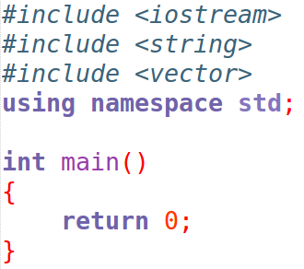
vector
First, you need to include the
<vector>
Library.

Slide 8
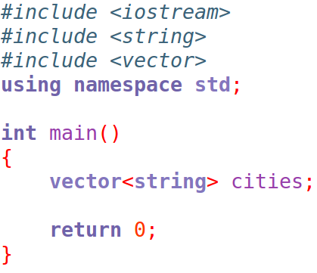
vector
Declare the vector variable, specifying the data-type that it will store within the < and > signs.

Slide 9
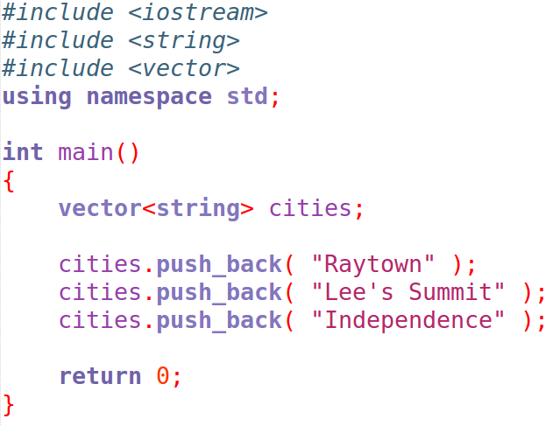
vector
Add items to the vector with the push_back function.
Element at index 0
Element at index 1
Element at index 2

Slide 10
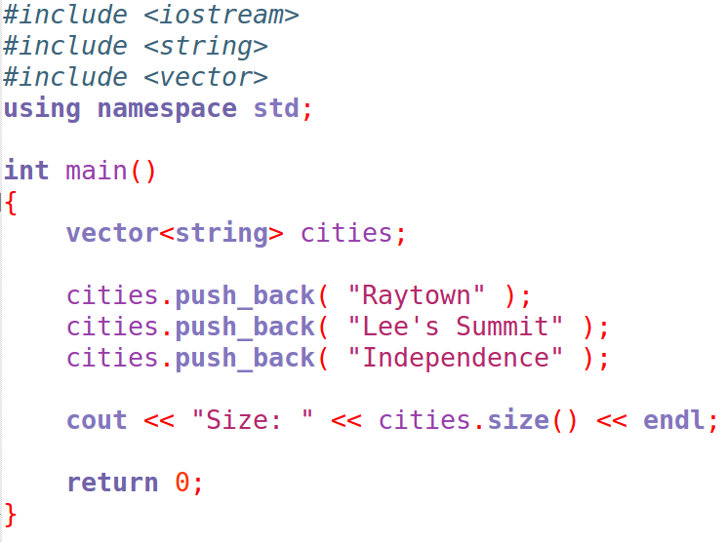
vector
You can get the size of the vector at any time with the size() function.

Slide 11
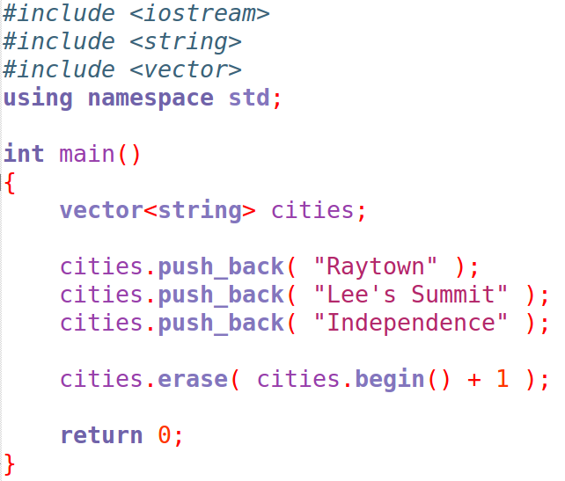
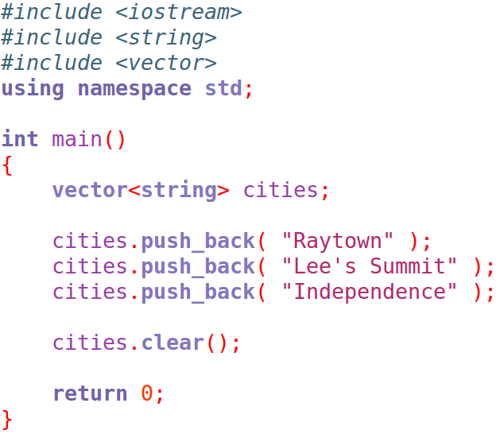
vector
To remove an item at a specific index, use the erase function.
The argument will be variable.begin() , then add the index #.
(more on what this is later.)
Remove item #1, Lee's Summit

Slide 12
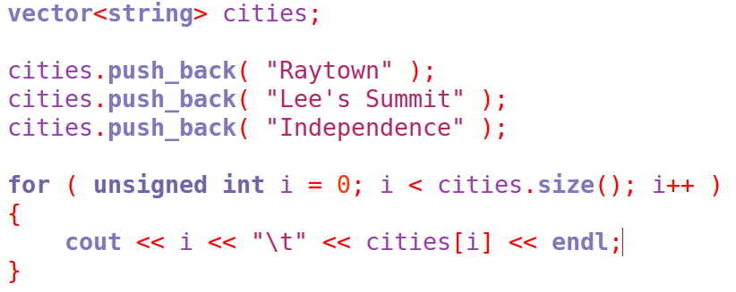
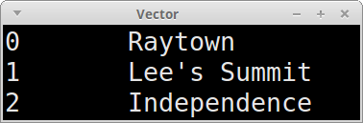
vector
You can easily output all the elements of the vector with a for loop, going from 0 to the size of the vector.
We can also use iterators to iterate through every element, but more on that later!

Slide 13
map

Slide 14
map
The map class is like an array, but the indices can be integers or other data-types. This is known as a key-value pair.
Each index must be unique, as that is the key that represents the value object.
To insert an item into a map, you need to create a pair object. Both the map and pair need to have the same template types.

Slide 15
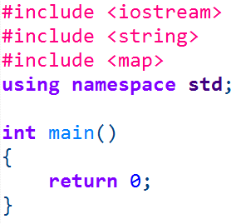
map
First, you need to include the
<map>
library.

Slide 16
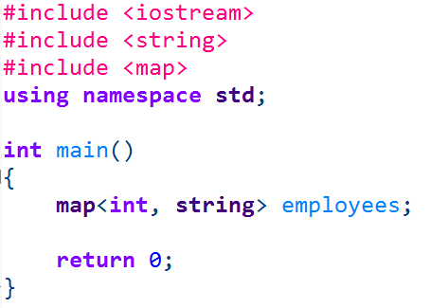
map
The map object needs two template types,
the key first and the value second.
For this example, the key is an integer – could be an employee ID
The value is a string – could be an employee name

Slide 17
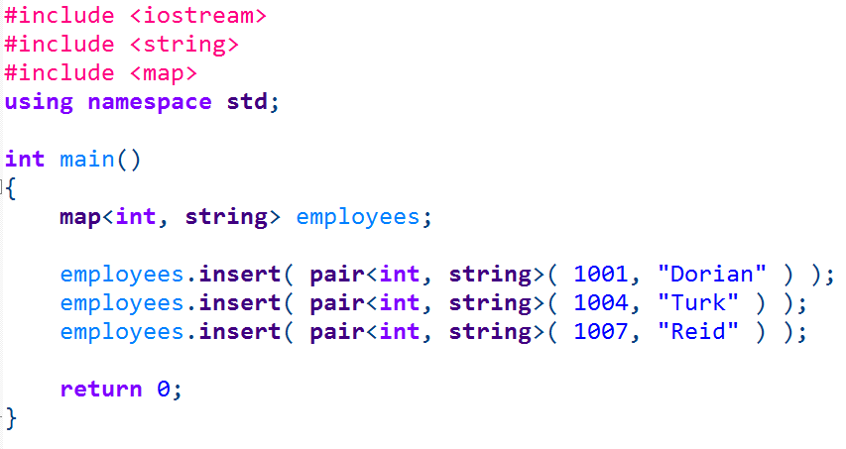
map
Use the insert function to insert a new element into the map.
But you need to pass in a pair object as the item being inserted.
You could declare the pair outside of the insert function, or just as the argument.

Slide 18
map
Use the insert function to insert a new element into the map.
The pair types need to match the map types.
Then, within parenthesis (the constructor), you pass in the values.

Slide 19
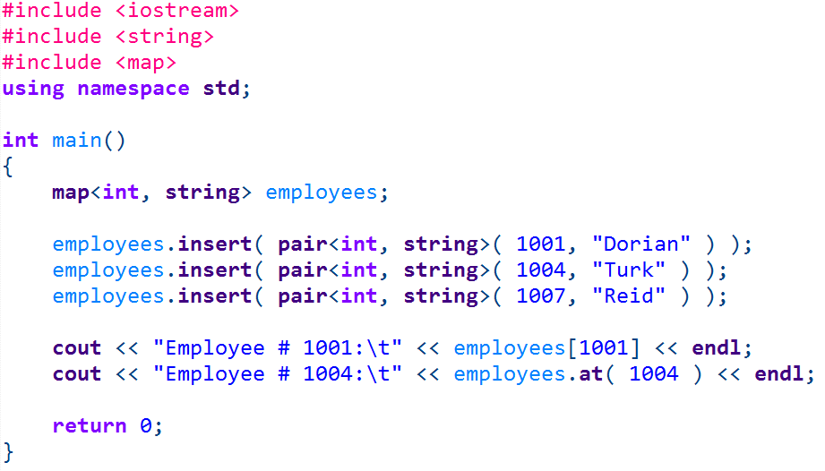
map
To access the value at a particular index, you can use the subscript operator with the key, or use the at function.

Slide 20
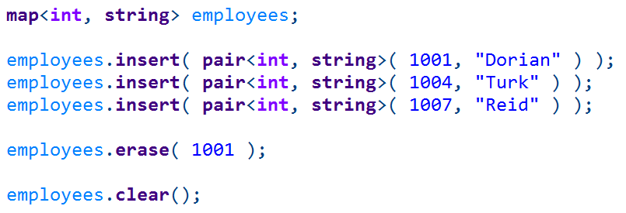
map
You can clear out the map with clear() function
You can erase a specific item with the erase() function, and pass in the key of the element.

Slide 21
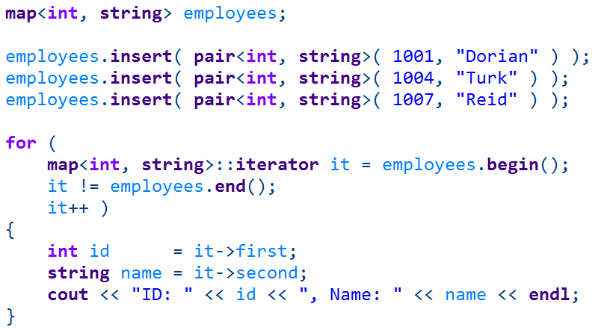
map
If you want to iterate through every item in the map, you will have to use iterators.
Yep, it looks weird.
Let’s break down this loop...

Slide 22
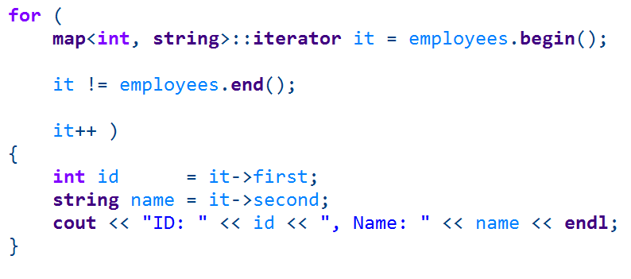
map
This is a for loop, but you’re used to seeing it like
for ( a = 0; a < size; a++ )
This loop is in the same order:
1. Declare a variable
2. Specify the criteria for the loop to continue
3. Specify what gets done every time through the loop.

Slide 23
map
First, we have to create an iterator.
It will be an iterator of your map, so use the map data-type with the same template types. Use ::iterator at the end. This whole thing is the data-type.
Next, “it” is the variable name of our iterator.
The initial value is the beginning of our map – which we can get with
variablename.begin()

Slide 24
map
Second, we specify the criteria for when the loop will continue looping.
You will loop until you reach the end of the map, so it will run into variablename.end()

Slide 25
map
Finally, every time through the loop, we are going to increment the iterator. This will go to the next element in the map.

Slide 26
map
The iterator is essentially a pointer.
You can get the key of the element by accessing the first member.
You can get the value of the element by accessing the second member.

Slide 27
list

Slide 28


list
To use a list, you will need to include the <list> library.
To use a list, you will need to include the <list> library.
A list is similar to a vector, but there are differences!

Slide 29
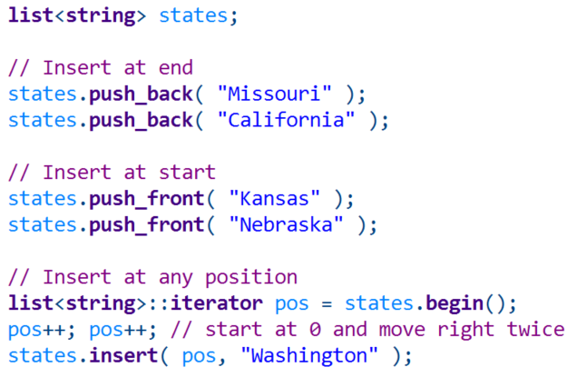
list
With vector, you are generally just adding items to the end of the array with the push_back function
To use a list, you will need to include the <list> library.
With a list, you can push to the end of the list
The beginning of the list
Or somewhere in-between!

Slide 30
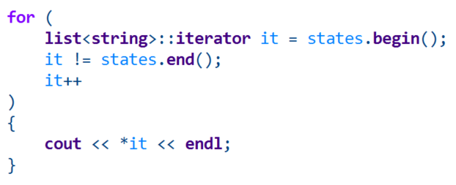
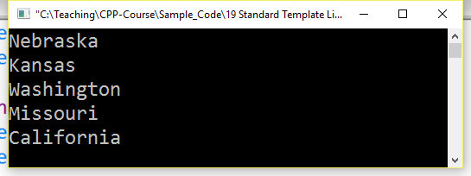
list
To use a list, you will need to include the <list> library.
But you can’t randomly access items at some index with the subscript operator [ ] like you can with a vector...
You will have to use an iterator to access every item in the list.
(Or to navigate to a specific index)

Slide 31

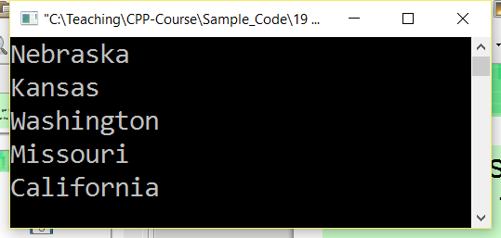
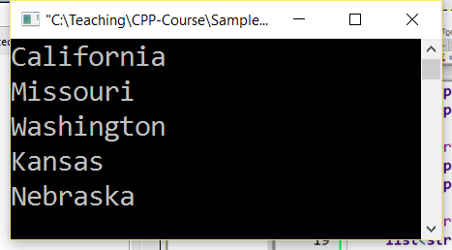
list
There is also a function called reverse() that will reverse your list elements
No reverse
Reverse

Slide 32

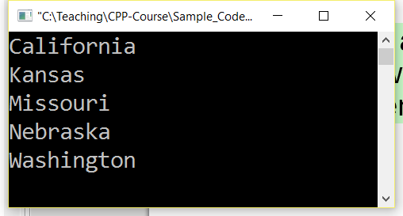
list
And a handy sort() function that will put your elements in order.
No sort
Sort

Slide 33
queue

Slide 34
queue
A queue is known as a
first-in-first-out
structure
To use a list, you will need to include the <list> library.
You can add items to the queue and remove items from the queue, and the first item to be added will be the first item to be removed.
0
George
1
John
2
Thomas
3
James
In C++ terms, you have
push_back() and pop_front()
But for queue, it is just push() and pop().

Slide 35
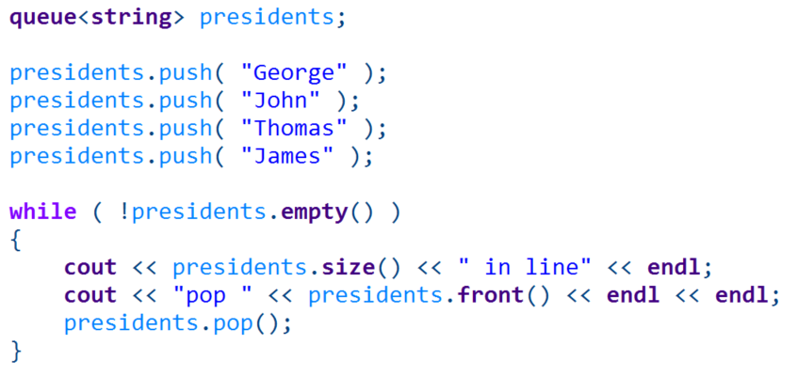
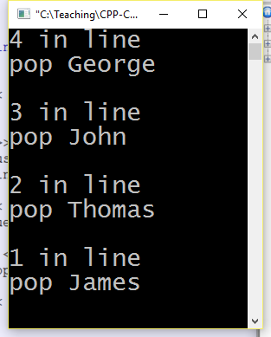
queue
As you push items into the queue, the first item goes in front and everything else “lines up” behind it.
A queue structure might be useful for modeling
incoming work to be processed, so that items that are received first are dealt with first.

Slide 36
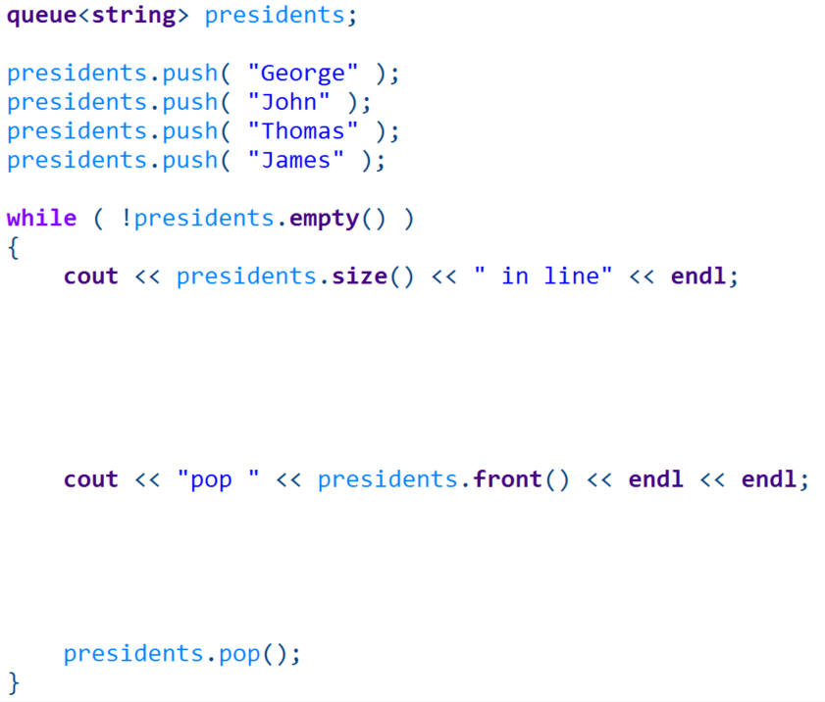
queue
Use push() to add an item to the queue
Empty() will return true or false
Or you can get the # of things in the queue with size()
Access the item at the front of the queue with front()
Remove the item at the front with pop()

Slide 37
stack

Slide 38
queue
A stack is known as a
first-in-last-out
structure
To use a list, you will need to include the <list> library.
The first item added to the stack will be the last item to be removed. (push_back, pop_back)
0
George
So when you push something onto the stack, it goes “on top”.
If you pop something off of the stack, it removes the “top-most” item.
1
John
2
Thomas
3
James

Slide 39
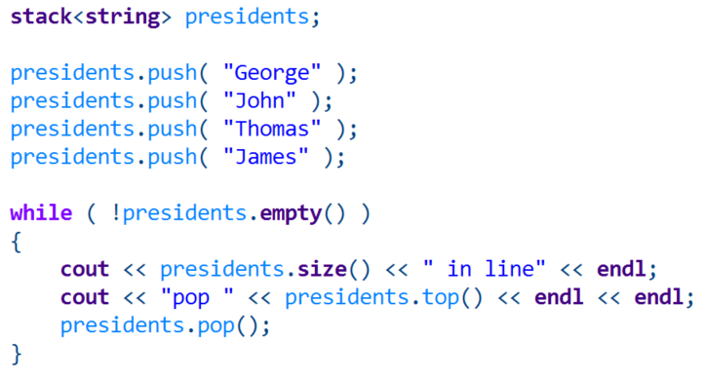
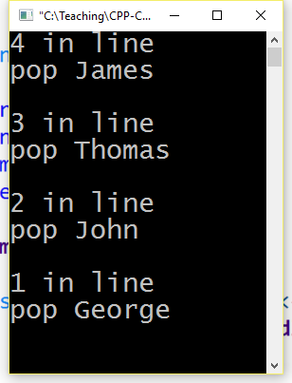
queue
The first item goes on the bottom, and all subsequent items end up on top of it.
And with a stack, you can only access the top-most item.

Slide 40
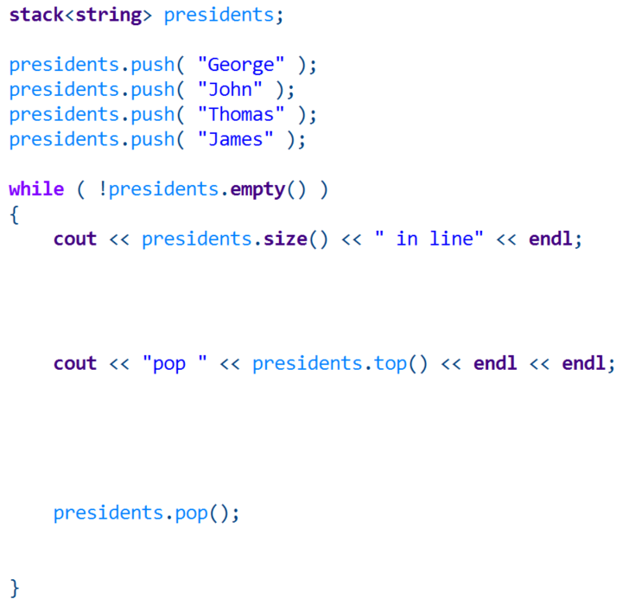
queue
Use push() to add items to the stack
Check if the stack is empty with empty()
Get the # of elements in the stack with size()
Look at the top-most item with top()
Remove the top-most item with pop()

Slide 41
Data structures
The C++ STL is pretty handy and it is good to be familiar with how to use them.
The cplusplus.com reference page also has a list of functions and sample code for using these structures!

